Slide 1
What are the Challenges for TinyML?
Part C

Slide 2


Embedded
Systems
TinyML
Machine
Learning

Slide 3

Embedded
Systems
TinyML
Machine
Learning
Machine
Learning

Slide 4
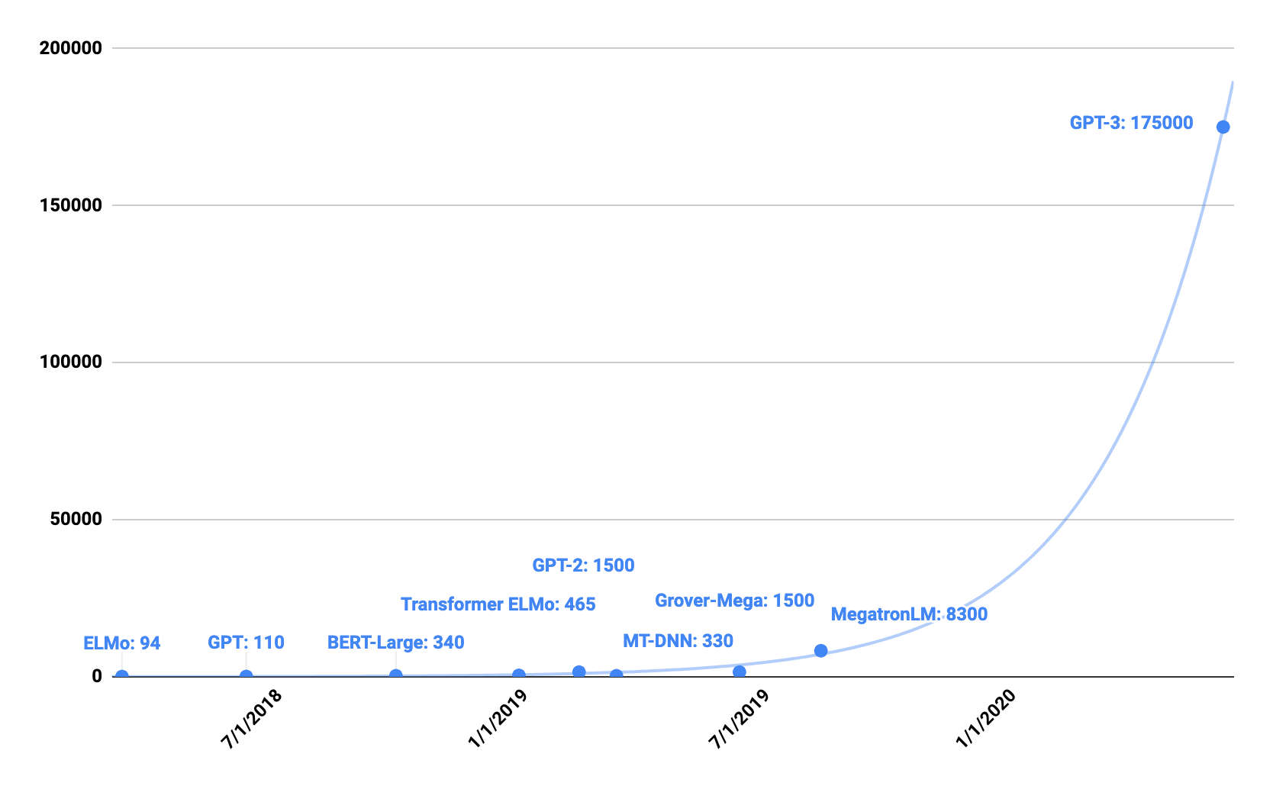






ML Model Size Growth
Number of Parameters (in Millions)
Notes:
Machine learning models are growing fast in complexity
NLP models have increased by ??X between 2018 and 2020

Slide 5
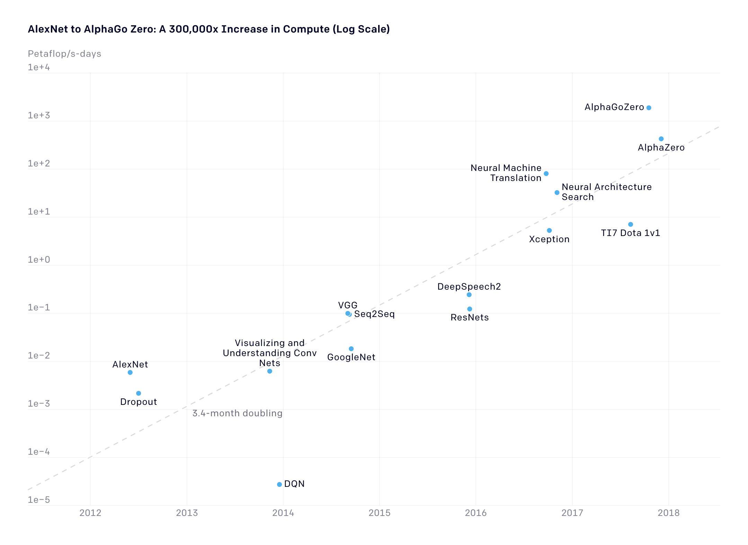
ML Compute Needs
(2012 to Present Day)
In recent years, computing needs grew by 300,000x to train the machine learning models that are widely deployed in the industry
Source: https://openai.com
Notes:
https://openai.com/blog/ai-and-compute/

Slide 6
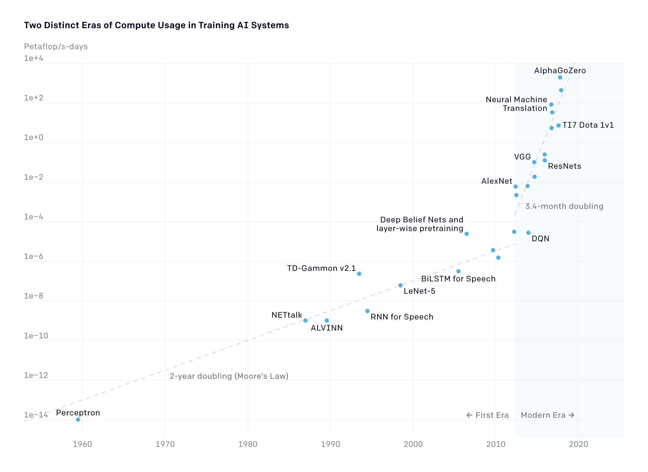
ML Compute Needs (from the 1960s)
In recent years, the amount of computing needed has grown remarkably fast.
Compute requirements are doubling nearly every 3 to 4 months
Source: https://openai.com

Slide 7
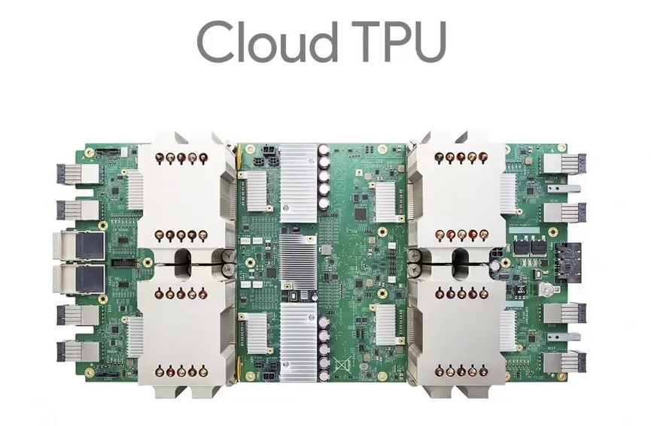
Source: Google
Notes:
https://heartbeat.fritz.ai/step-by-step-use-of-google-colab-free-tpu-75f8629492b3
Hook visual aspect of the image--something we can see in the chip
Fair use won’t cover decorative/illustrative purposes--

Slide 8
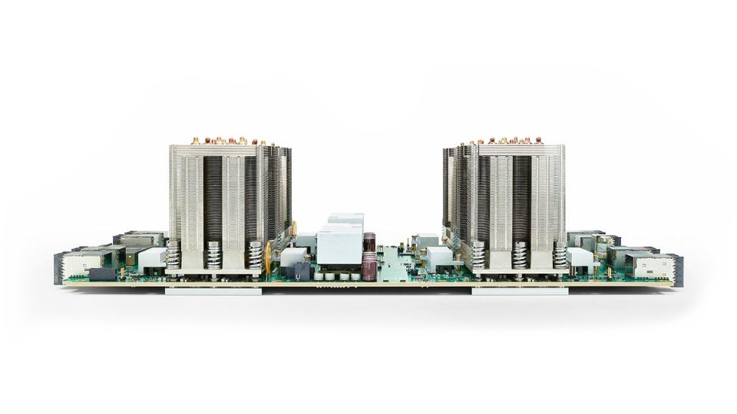
Source: Google
Notes:
https://moorinsightsstrategy.com/google-cloud-tpu-strategic-implications-for-google-nvidia-and-the-machine-learning-industry/

Slide 9
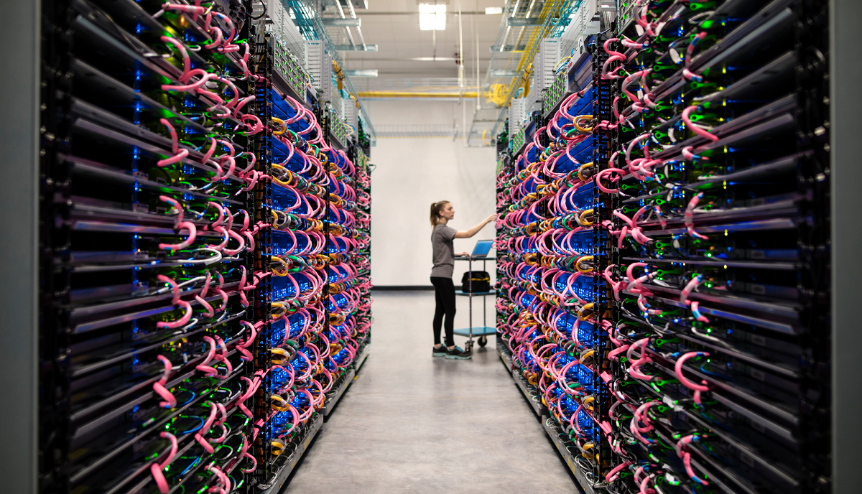
Source: Google
Notes:
https://venturebeat.com/2018/06/19/googles-cloud-tpu-comes-to-europe-and-asia-with-preemptible-pricing/

Slide 10
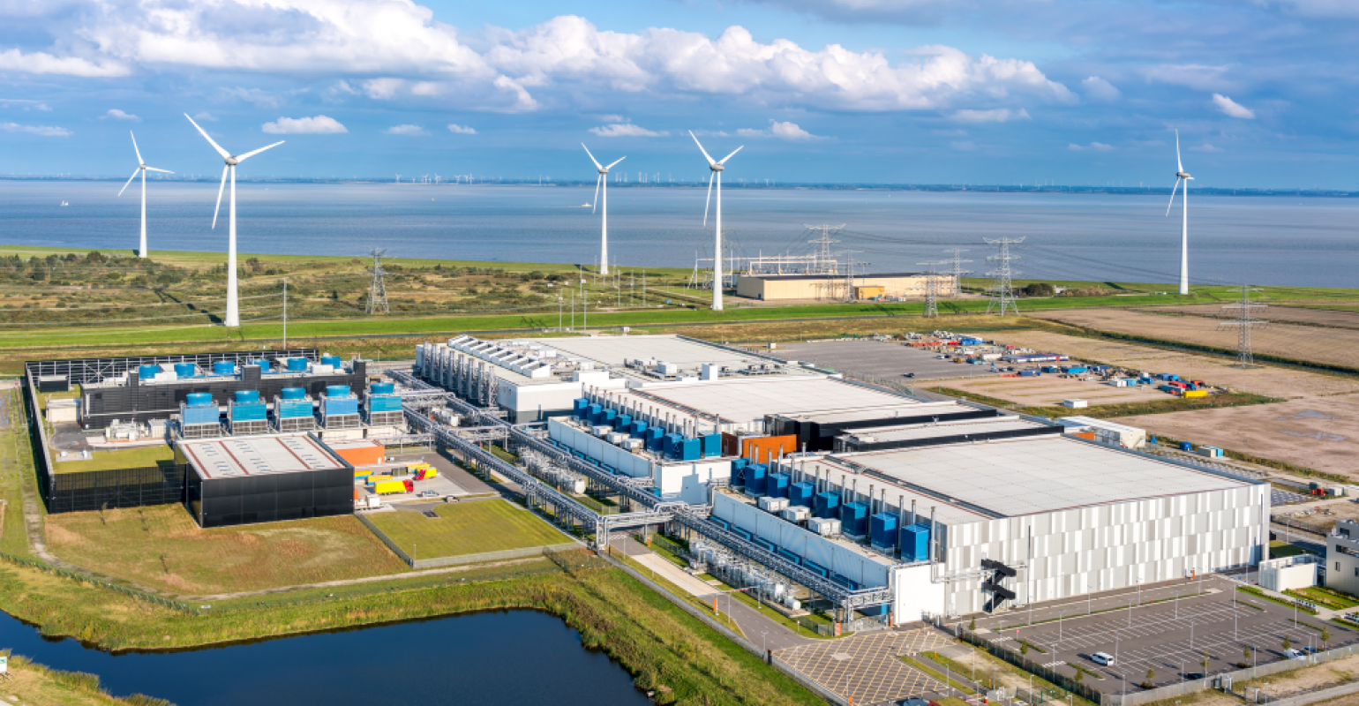
Source: Google
Notes:
https://www.google.com/about/datacenters/locations/eemshaven/#:~:text=Google%20is%20proud%20to%20call,one%20of%20our%20data%20centers.&text=This%20will%20bring%20our%20total,catering%20staff%2C%20and%20facility%20managers.
Try to remain explicit--international growth, Netherlands, what is important about the international/European growth

Slide 11
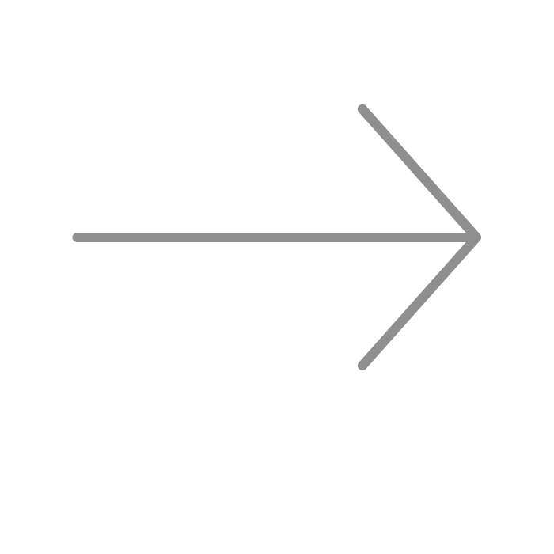
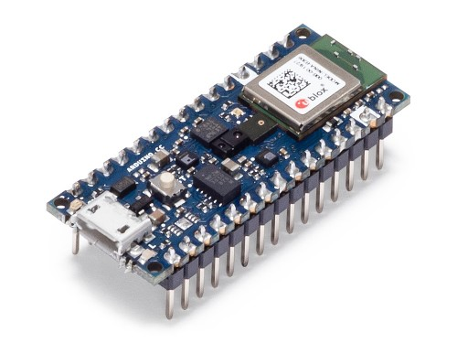
TinyML

Slide 12
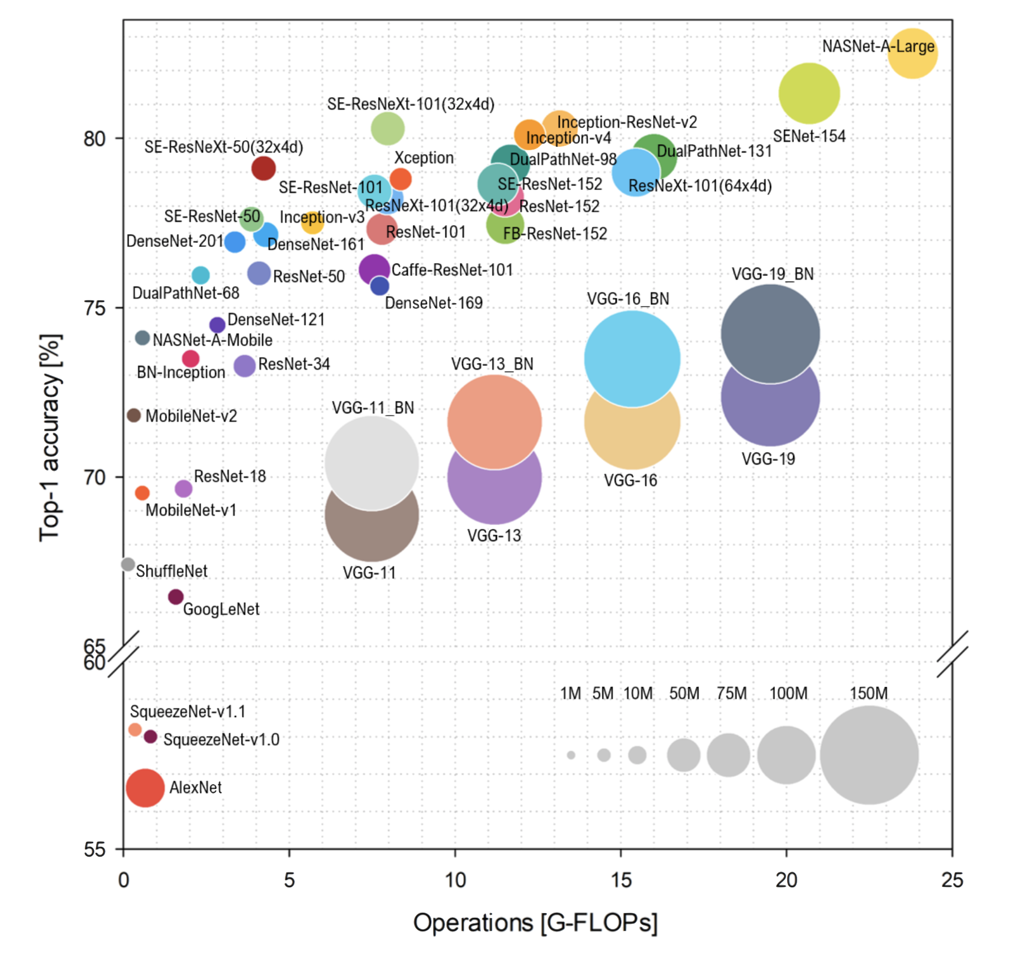
ML Model Evolution
Source: S. Bianco, R. Cadene, L. Celona, and P. Napoletano, “Benchmark analysis of representative deep neural network architectures,” IEEE Access, vol. 6, pp. 64 270–64 277, 2018
Notes:
https://lib.dr.iastate.edu/cgi/viewcontent.cgi?article=8563&context=etd
Increase in creativity -- harder to justify fair use

Slide 13

ML Model Evolution
AlexNet (2012)
57.1% accuracy
61MB in size
Source: S. Bianco, R. Cadene, L. Celona, and P. Napoletano, “Benchmark analysis of representative deep neural network architectures,” IEEE Access, vol. 6, pp. 64 270–64 277, 2018
Notes:
https://lib.dr.iastate.edu/cgi/viewcontent.cgi?article=8563&context=etd

Slide 14
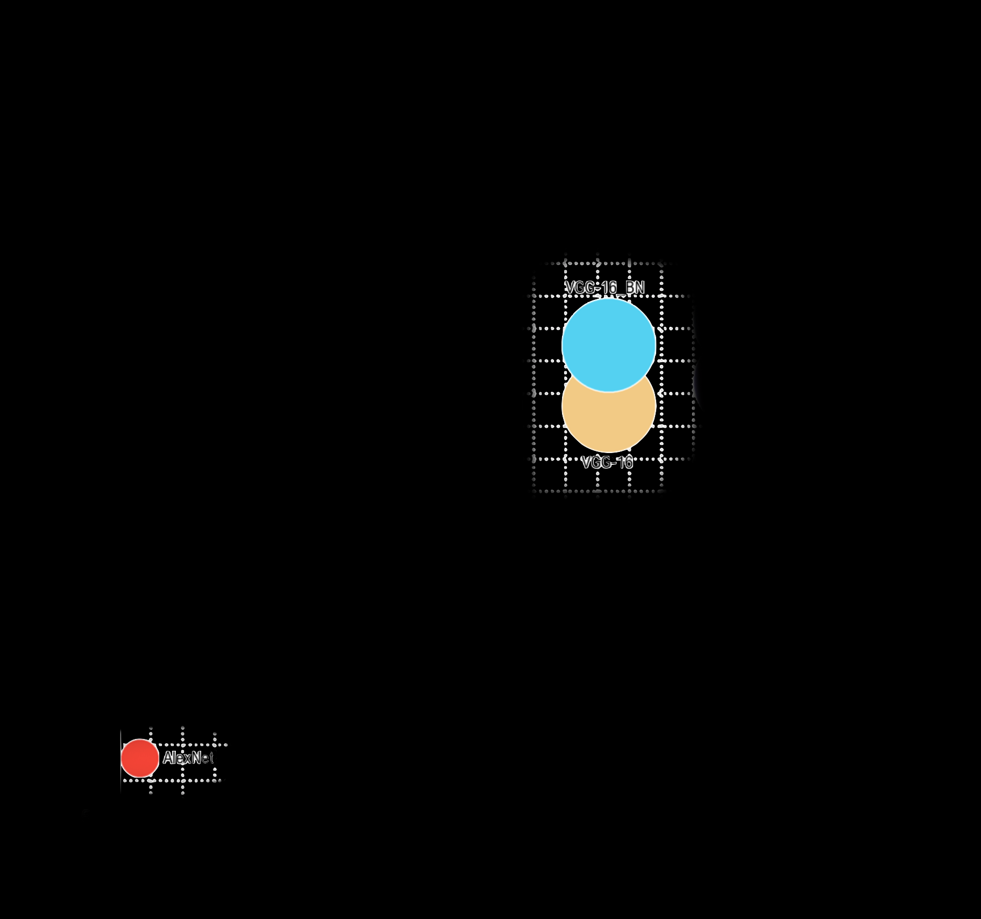
ML Model Evolution
VGGNet (2014) [VGG-16]
71.5% accuracy
528MB in size
Source: S. Bianco, R. Cadene, L. Celona, and P. Napoletano, “Benchmark analysis of representative deep neural network architectures,” IEEE Access, vol. 6, pp. 64 270–64 277, 2018
Notes:
https://lib.dr.iastate.edu/cgi/viewcontent.cgi?article=8563&context=etd

Slide 15
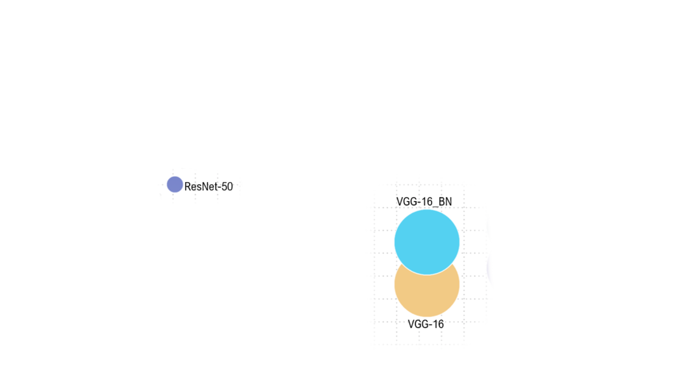
ML Model Evolution
ResNet (2015)
75.8% accuracy
22.7MB in size
Source: S. Bianco, R. Cadene, L. Celona, and P. Napoletano, “Benchmark analysis of representative deep neural network architectures,” IEEE Access, vol. 6, pp. 64 270–64 277, 2018
Notes:
https://lib.dr.iastate.edu/cgi/viewcontent.cgi?article=8563&context=etd

Slide 16
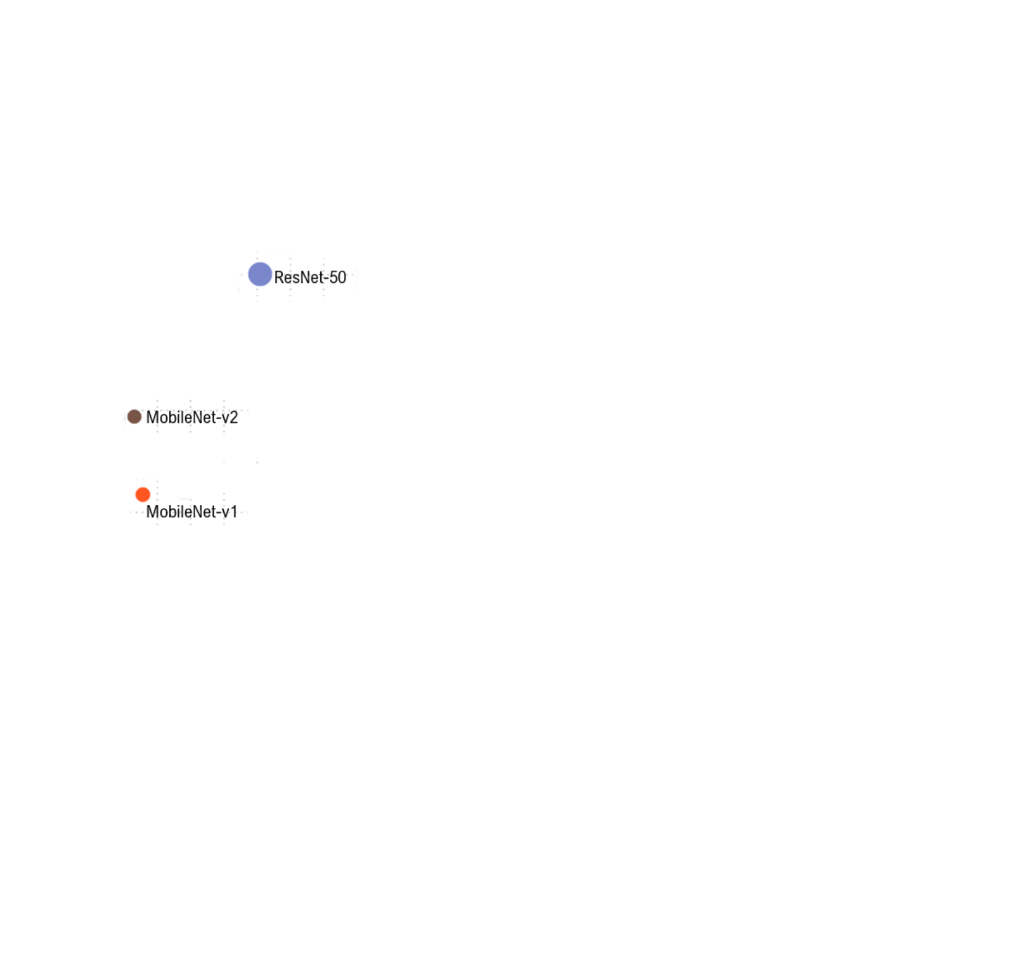
ML Model Evolution
MobileNet (2015)
MobileNetv1
70.6% accuracy
16.9MB in size
Source: S. Bianco, R. Cadene, L. Celona, and P. Napoletano, “Benchmark analysis of representative deep neural network architectures,” IEEE Access, vol. 6, pp. 64 270–64 277, 2018
Notes:
https://lib.dr.iastate.edu/cgi/viewcontent.cgi?article=8563&context=etd

Slide 17
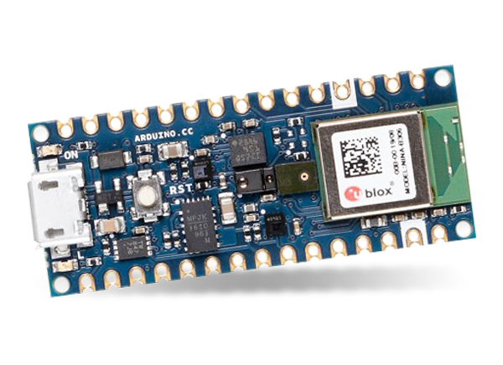
ML Model Evolution
Problem:
Our board (in your kit for Course 3) only has 256KB of RAM (memory) yet MobileNetv1 needs 16.9MB!
MobileNet (2015)
MobileNetv1
70.6% accuracy
16.9MB in size
Source: S. Bianco, R. Cadene, L. Celona, and P. Napoletano, “Benchmark analysis of representative deep neural network architectures,” IEEE Access, vol. 6, pp. 64 270–64 277, 2018
Notes:
https://lib.dr.iastate.edu/cgi/viewcontent.cgi?article=8563&context=etd

Slide 18
Fullscreen. Show presenter.

